Slide 1
Big Mountain Resort, Montana
Recommendations for ticket pricing

Slide 2
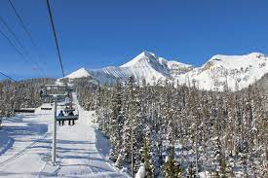
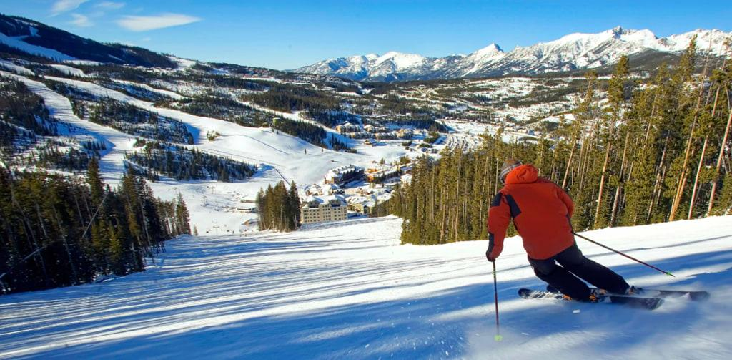
Problem Statement
How can Big Mountain Resort reorganize its ticket pricing strategy, currently based on the average price of resorts in its market segment, to one based on resort facilities and the value these facilities bring to the ticket price in order to aid investment strategy and offset additional operating costs incurred for this season?
Big Mountain Resort
Big Mountain Resort offers spectacular views of Glacier National Park and Flathead National Forest, with access to 105 trails. Every year about 350,000 people ski or snowboard at Big Mountain. The business requests some guidance on how to select a better value for their ticket price. By considering a number of changes the resort hopes to increase ticket price and/or reduce cost without reducing ticket price.

Slide 3
Current Resort’s Pricing Strategy
For Big Mountain Resort to base their pricing on the market average will not be enough to maximize their capitalization investment and is not sustainable to increase revenue amid increasing operating costs.
Recommendations
Our Model suggests that Big Mountain Resort’s ticket price is lower than the predicted model by 16.31%, and the resort has many scenarios for cutting costs by closing runs or increasing ticket price by increasing vertical drop, adding snow making coverage, and an additional chair lift.
Increasing the vertical drop by 150 ft and adding an additional chair lift would increase the ticket price by 10.63% from $81 to $87.61, resulting in revenue increase by $15,065,471.
Adding 2 acres of snow making would increase the ticket price by 12.22% from $81 to $90.90, resulting in revenue increase by $17,322,717.

Slide 4
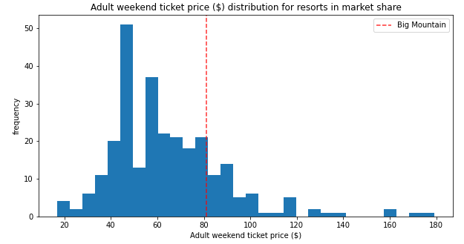
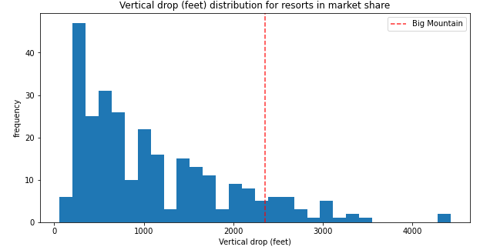
Big Mountain’s Ticket Price compared to other Resorts Ticket Price.
Big Mountain Resort is doing well for vertical drop but there are still a few resorts with greater drops.

Slide 5
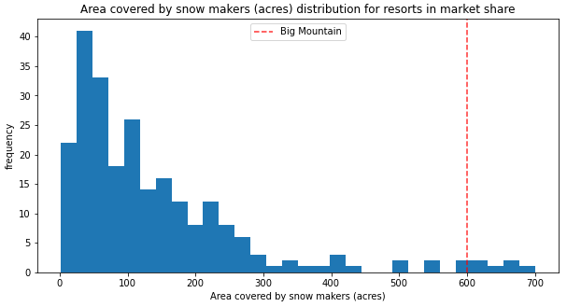
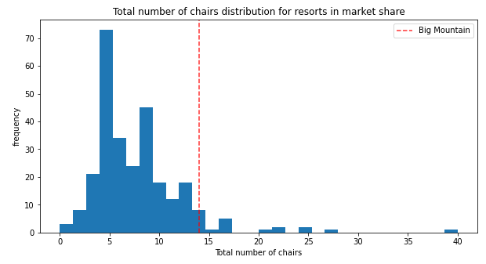
Big Mountain is very high up the league table of snow making area.
Big Mountain has among the highest number of total chairs, resorts with more are few and appear to be outliers.

Slide 6
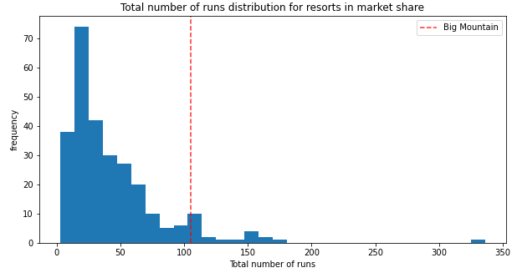
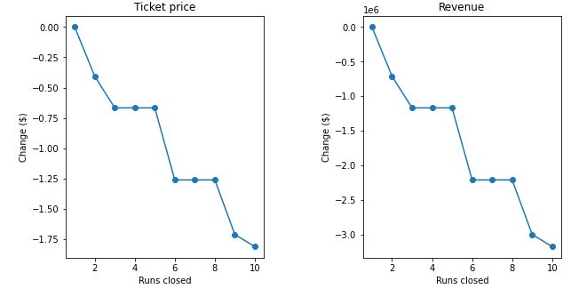
Big Mountain Resort has been reviewing a potential scenario for cutting costs by permanently closing down up to 10 of the least used runs.
Our Model predicted the following when it comes to closing up to 10 runs:
Closing one run will have no impact on Ticket price or revenue.
Closing 2 runs reduces support for ticket price and therefore revenue by $0.40 and $750,000 respectively.
Closing down 3 runs has the same effect as closing down 4 or 5. The loss in ticket price and revenue is $0.67 and $1.250M respectively.
Closing 10 runs reduces support for ticket price and therefore revenue by $1.71 and $3M respectively.
Because there is no visibility on the operating cost per run, we cannot determine how much cost saving will be offset by the loss in revenue after closing more than one run.

Slide 7
Data Limitations
The main data is missing some important information like:
Adult Weekday ticket price and operating costs for most of the resort’s features (operating cost per run, for example, is missing).
In order for the model to provide a better price prediction it would be beneficial to get another source of data.

Slide 8
Conclusions
After applying the model for ski resort ticket pricing and using it to explore Big Mountain Resort’s potential scenarios for increasing revenue:
The scenario where we managed to gain the highest revenue increase possible was by increasing the vertical drop by 150 ft, adding one chair lift, adding one run, and adding 2 acres of snow making coverage. This scenario has increased ticket price by 12.22% from $81 to $90.90, resulting in a revenue increase of $17,322,717.
Due to lack of data in regards of operating cost per used run and weekdays ticket price, our model cannot recommend closing down used runs or implementing a dynamic ticket pricing.

